Slide 1
Springboard Capstone 2 WESAD dataset Meditation and Social Stress
Walter Piper

Slide 2
Problem identification: Resilience to social stress during performative endeavors
Can wearables play a role in measuring resilience?
Sympathetic nervous system is known to respond to social stress.
Does meditation increase resilience?

Slide 3
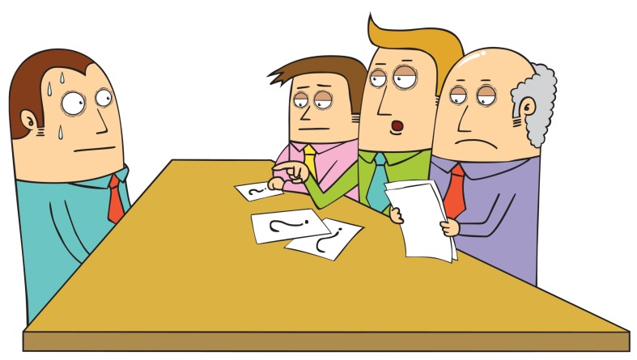
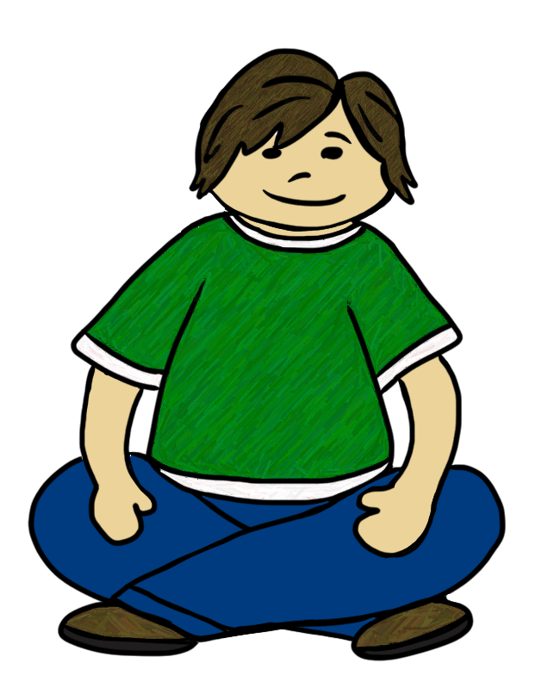
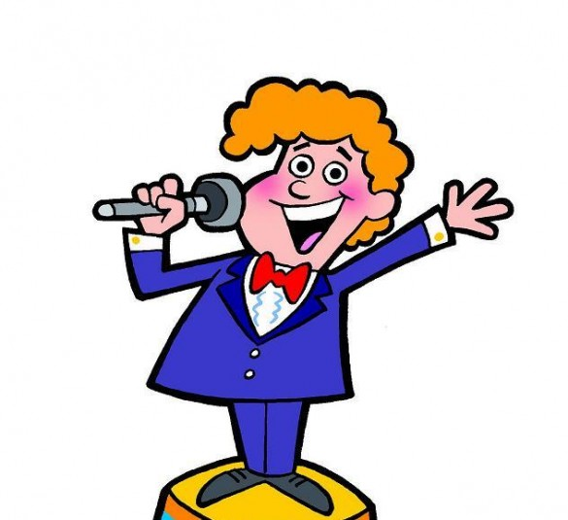

Wearable Stress and Affect Detection (WESAD) dataset
15 human subjects
Baseline, Trier social stress test, amusement, 2 meditation sessions.
Two experimental conditions (1st meditation/amusement before vs. after social stress):

Slide 4
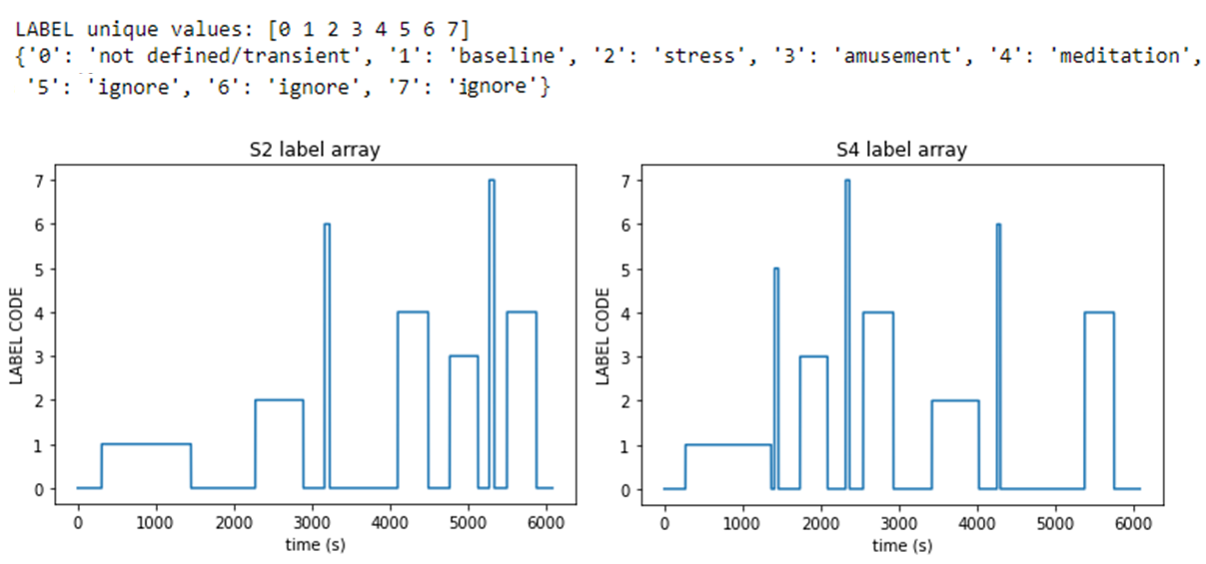
Wearable Stress and Affect Detection (WESAD) dataset
15 human subjects
Baseline, Trier social stress test, amusement, 2 meditation sessions.
Two experimental conditions (1st meditation/amusement before vs. after social stress):
Social stress first
Meditation first
Amusement & meditation
Amusement & meditation
Social stress
Social stress

Slide 5
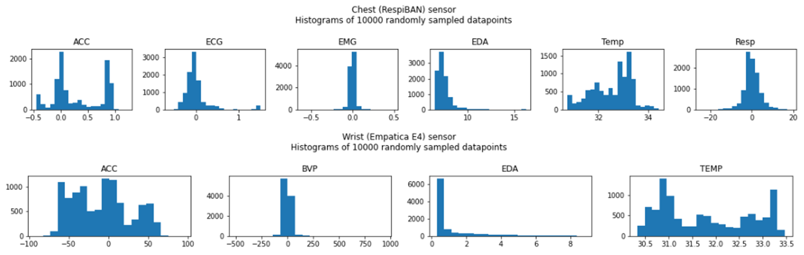
WESAD dataset
Wearables record physio metrics:
Electrocardiography, Electrodermal activity, Electromyography, Respiration, Accelerometers on chest and wrist.
Self-report affective questionnaires
Personal details (age, weight, smoker status…)

Slide 6
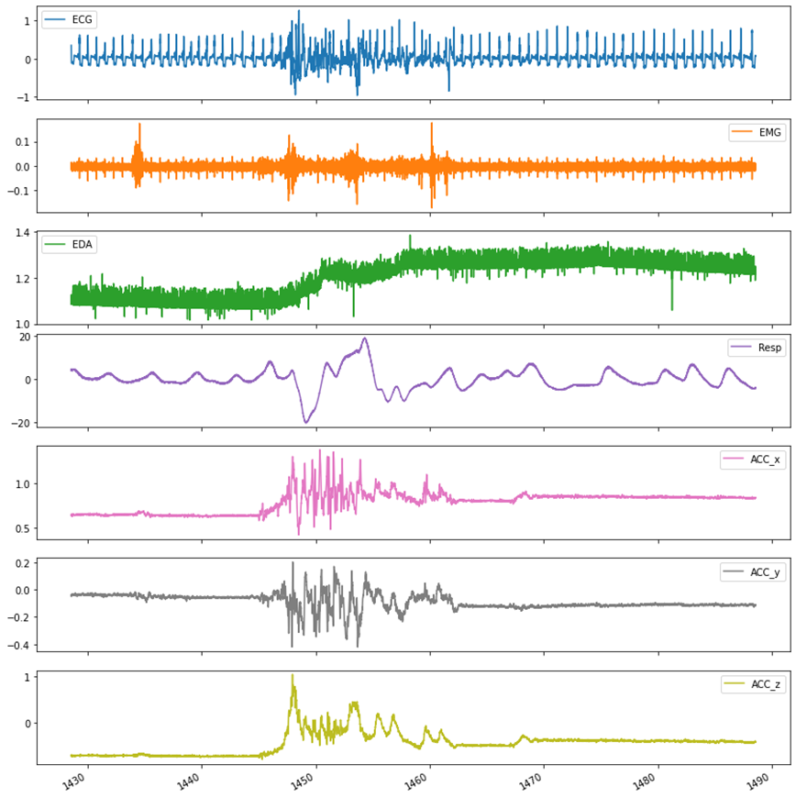
WESAD dataset

Slide 7
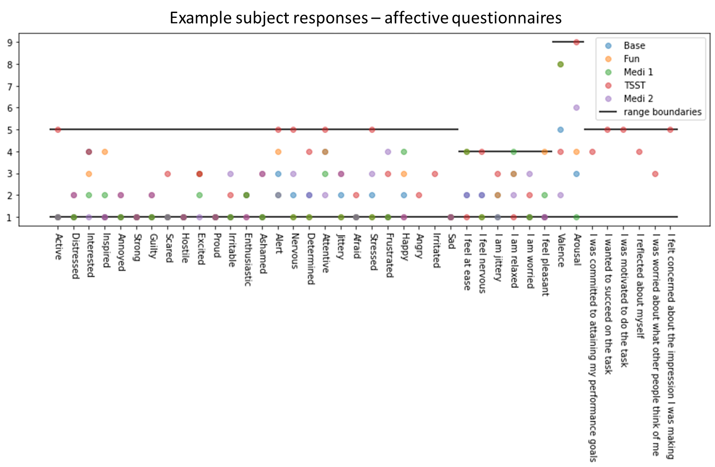
WESAD dataset
Wearables record physio metrics:
Electrocardiography, Electrodermal activity, Electromyography, Respiration, Accelerometers on chest and wrist.
Self-report affective questionnaires
Personal details (age, weight, smoker status…)

Slide 8
WESAD dataset
Did you drink coffee today?
NO 11
YES 4
Did you drink coffee within the last hour?
NO 15
Did you do any sports today?
NO 13
YES 2
Are you a smoker?
NO 14
YES 1
Did you smoke within the last hour?
NO 15
Do you feel ill today?
NO 14
YES 1
 | Age | Height (cm) | Weight (kg)
mean | 27.5 | 177.6 | 73.1
std | 2.45 | 6.75 | 10.27
Wearables record physio metrics:
Electrocardiography, Electrodermal activity, Electromyography, Respiration, Accelerometers on chest and wrist.
Self-report affective questionnaires
Personal details (age, weight, smoker status…)
Categorical data later encoded by one-hot encoding
Gender
male 12
female 3
Dominant hand
right 14
left 1

Slide 9
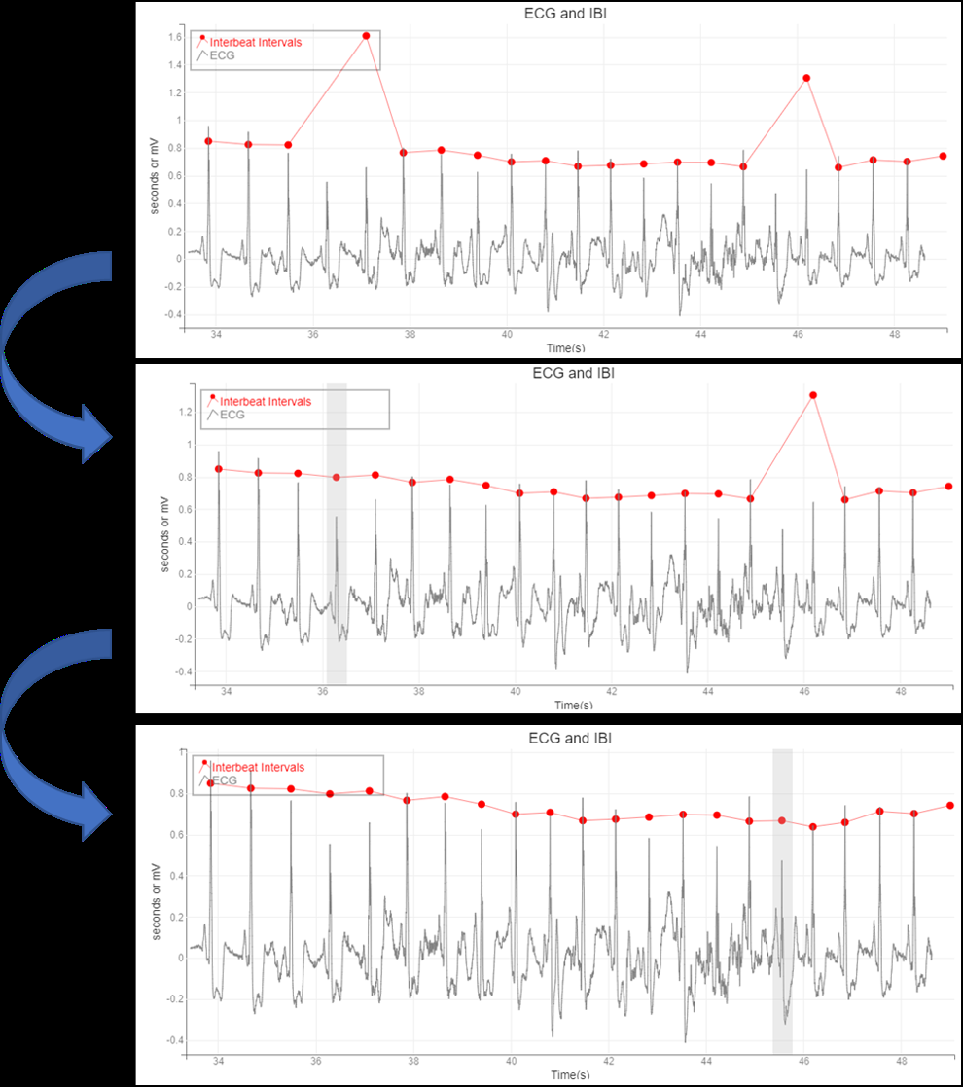
Preprocessing transformations: Electrocardiogram (ECG)
Biosppy package
Hamilton segmentation algorithm for ECG
Followed by custom GUI to clean errors
ipywidgets
bqplot
The reciprocal of interbeat interval is heart rate

Slide 10
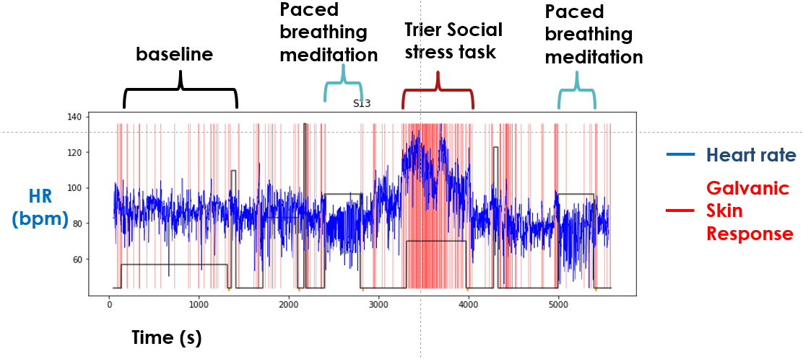
Preprocessing transformations: Electrodermal activity (EDA)
Downsample EDA to 4 Hz
Difference to obtain change in EDA
Examine with Scipy’s find_peaks
Peak_prominence argument was varied to obtain 200-500 peaks per subject

Slide 11
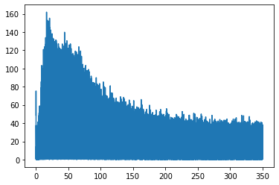
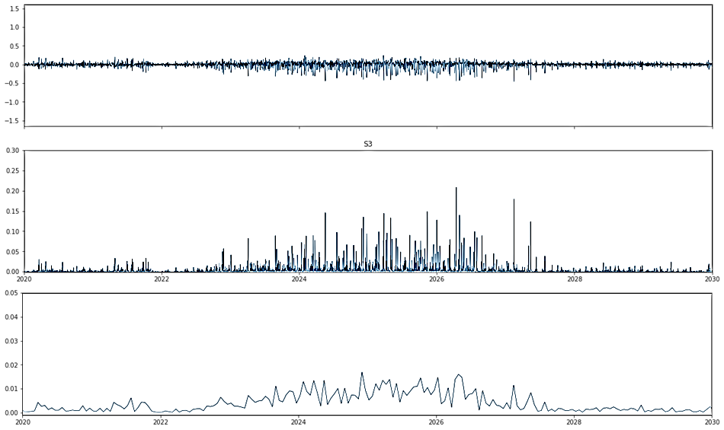
Preprocessing transformations: Electromyography (EMG)
Fourier Transform of EMG
High-pass FIR filter applied (32Hz)
Power
Raw EMG data is high-pass filtered (32Hz)
Then squared to obtain power
Then downsampled to 20Hz to smooth
Frequency (Hz)
Raw EMG
Filtered & squared
Downsampled

Slide 12
Preprocessing transformations: Accelerometers (chest and wrist)
Raw data differenced
Then squared
Then downsampled
10 Hz for chest accelerometer
8 Hz for wrist accelerometer

Slide 13
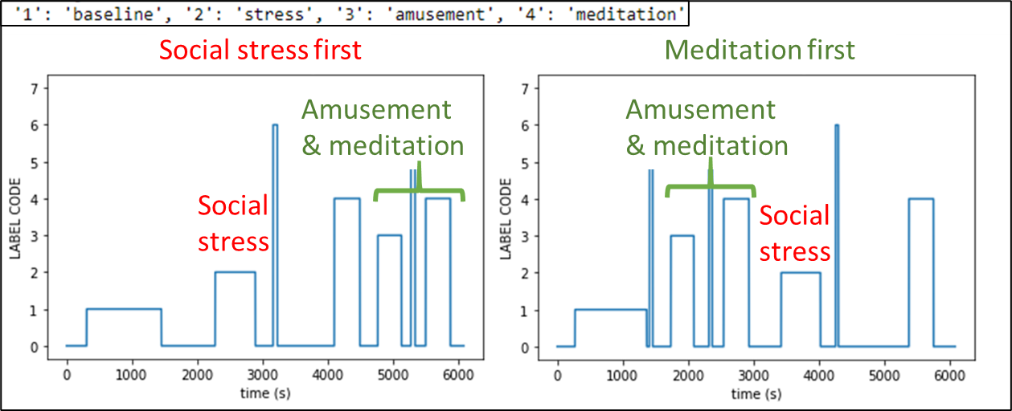
Aggregation/ Segmentation
Physio metrics were aggregated over entire task segments to create features.
Aggregation method was specific to each physio metric.
ECG-derived interbeat intervals
Mean heart rate (HR) – beats per minute
Root-mean-square of successive differences to obtain heart-rate-variability (HRV)
EDA-derived galvanic skin responses
Count divided by task duration (mean of Boolean array)
EMG & Accelerometers
Mean of previously obtained power values

Slide 14
Respiration
Transformation:
Downsampled to 10 Hz
Aggregation for respiration consistency/coherence:
Total energy of autocorrelation function (up to 7000 lags)

Slide 15
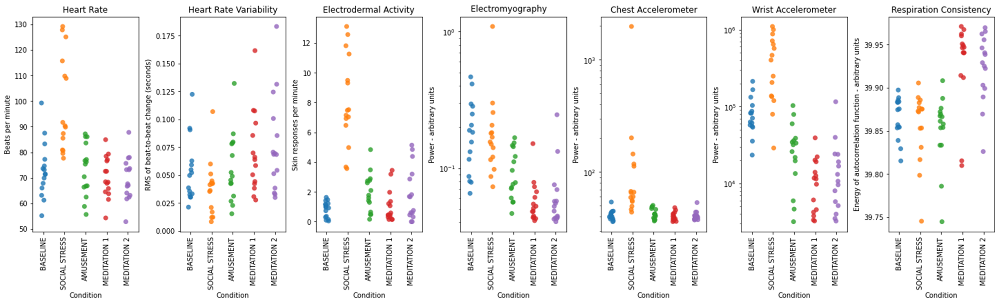
Exploratory Data Analysis
Different tasks display expected physiological profiles
Social stress – high heart rate, high electrodermal activity
Consistent with sympathetic nervous system activation

Slide 16
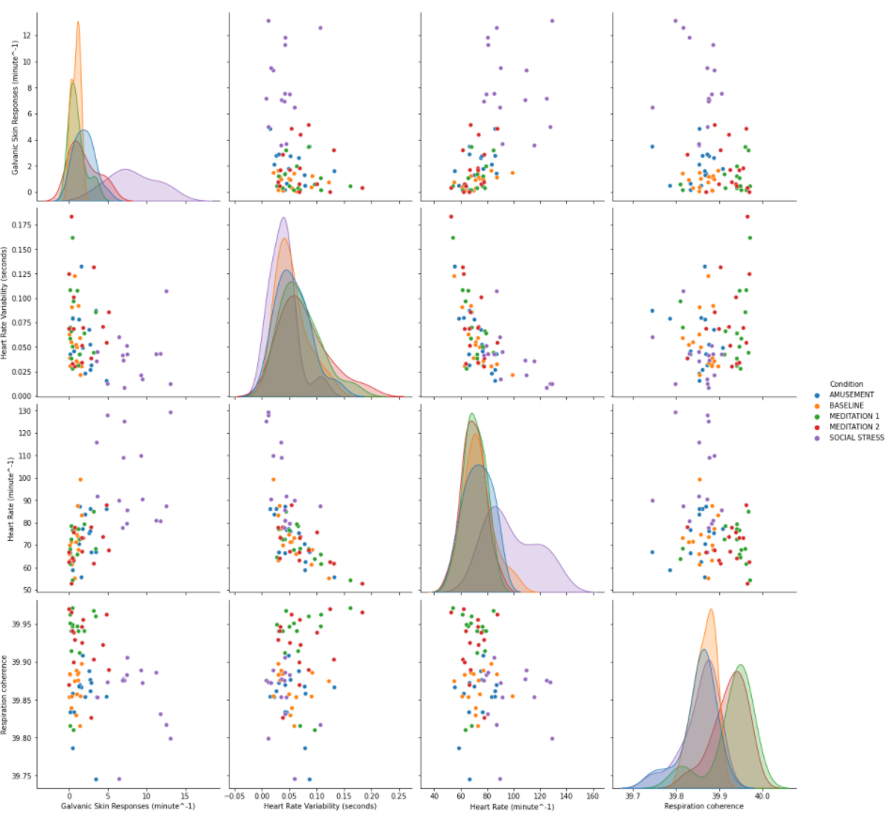
Exploratory Data Analysis
Galvanic skin responses
Heart rate correlated with electrodermal activity (Galvanic skin responses)
Heart rate inversely correlated with heart rate variability
May be an artifact of how HRV was calculated
Is consistent with opposing influences of sympathetic (HR) and parasympathetic (HRV) nervous systems.
Heart rate variability
Heart rate
Respiration coherence
Galvanic skin responses
Heart rate variability
Heart rate
Respiration coherence

Slide 17
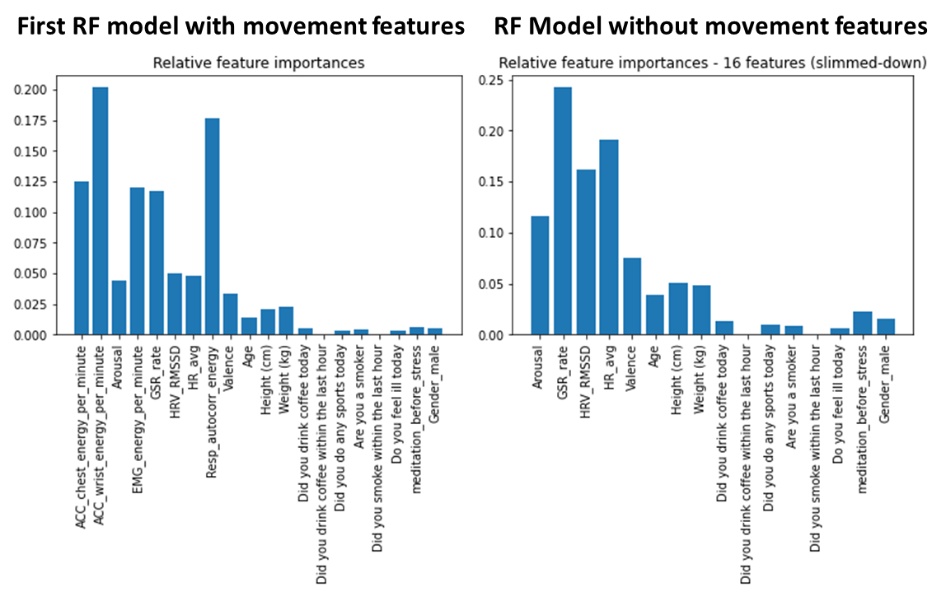
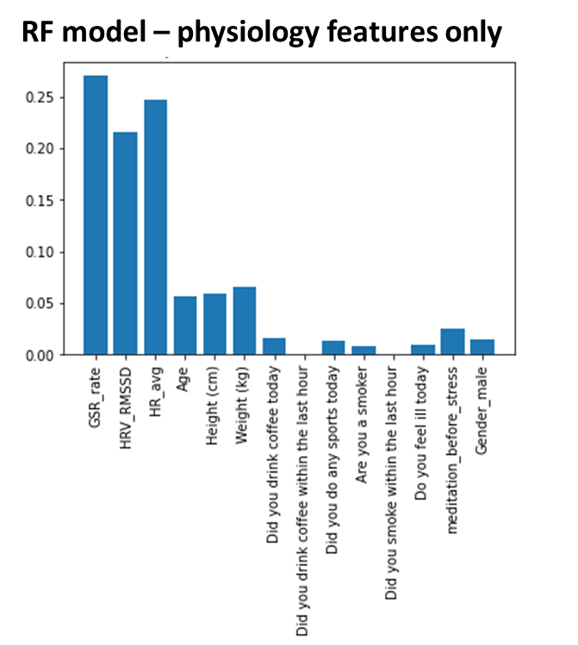
Feature Selection and Random Forest Model for Task Prediction
Class | RF physio + psych features, including EMG, accelerometers, & respiration | RF without EMG, accelerometers, & respiration | RF without EMG, accelerometers, respiration, and valence/arousal
Social stress | 100% | 88% | 75%
Amusement | 40% | 10% | 0%
Meditation | 96% | 74% | 61%
Baseline | 91% | 18% | 18%

Slide 18
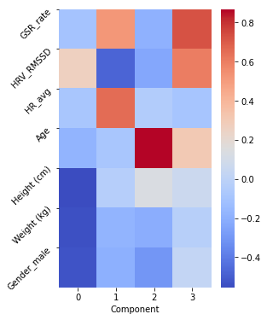
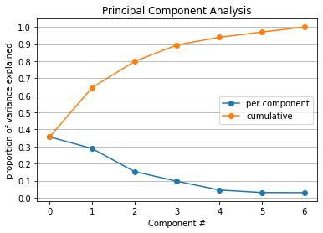
Modeling the Social Stress task Predicting amusement/meditation before stress
Indicative of autonomic nervous system activity
Step 0 – Standard scaler (Z-score)
Step 1 – Principal Component Analysis

Slide 19
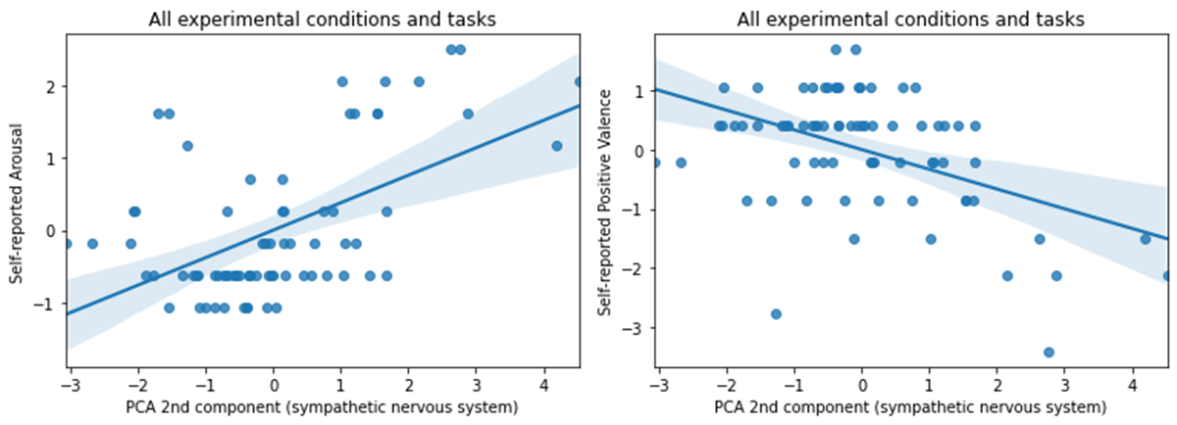
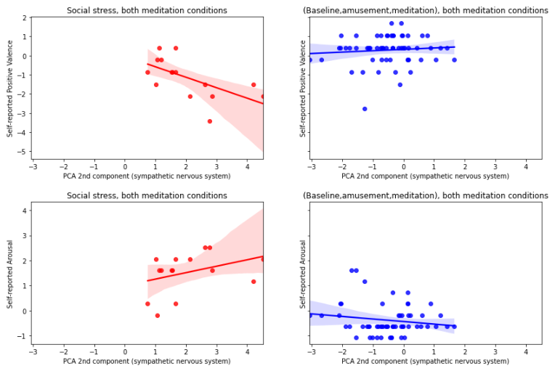
Psychological correlates of sympathetic nervous system
Social stress
All other task segments

Slide 20
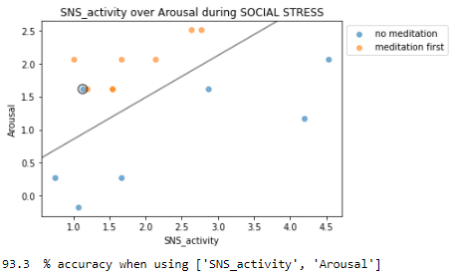
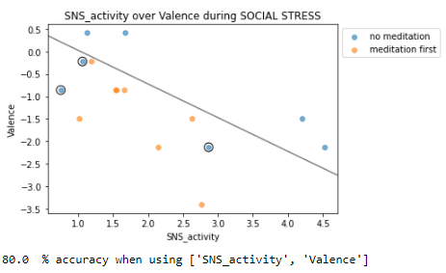
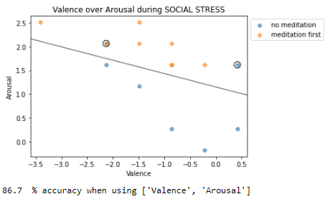
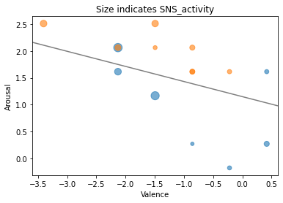
Modeling (Predicting recent meditation condition)
2-dimensional visualizations
With arousal over SNS model:
Support vectors are significantly different:
p=0.002

Slide 21
Final Modeling
Arousal, Valence, and SNS activity (2nd PCA component) were used as features.
Experimental condition (meditation before stress versus no meditation) was target.
Due to small sample size, a variation of cross-validation was used to obtain accuracies:
Repeated 1000 times: 12 training points, 3 test points (sampled without replacement)
Class | Support Vector Classifier (C=1) | Logistic Regression (C=10)
Meditators | 99.3% | 100%
Non-meditators | 64.7% | 65.9%
Total | 83.1% | 84.3%

Slide 22
Recommendations
If findings hold up to further research:
Meditation and/or amusement can be used to buffer against social stress.
Wearable consumer tech can be used to help optimize the way we prepare for social stress.

Slide 23
Future directions
These findings should be replicated with larger sample size.
Models did well in identifying meditators, but less well with non-meditators. Perhaps there are observable patterns in some non-meditators that indicate they are already ready for social stress. If so, wearable devices could identify and guide people who are not ready for social stress.
Future work could try using smaller segments with the aim of real-time implementation of similar models.

